Slide 1
Art Virtual Learning
High School Advanced Photography
Small Subject
Big Vision Project
April 27, 2020

Slide 2
High School Advanced Photography
Lesson: Miniatures
April 27
Objective/Learning Target:
To be more visually creative in seeing your world differently from a varied point of view with small subject matter in a skewed world.

Slide 3
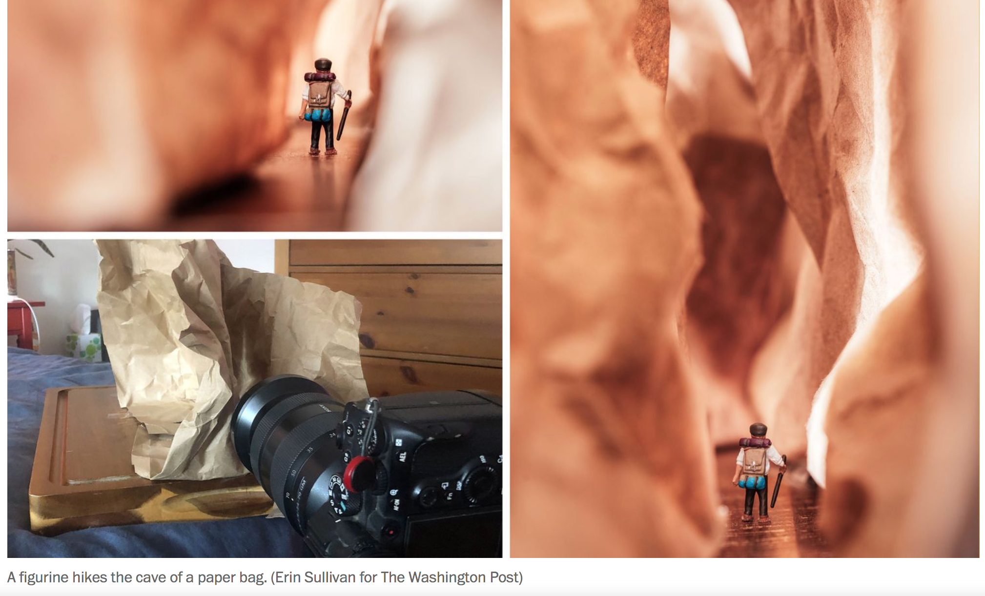
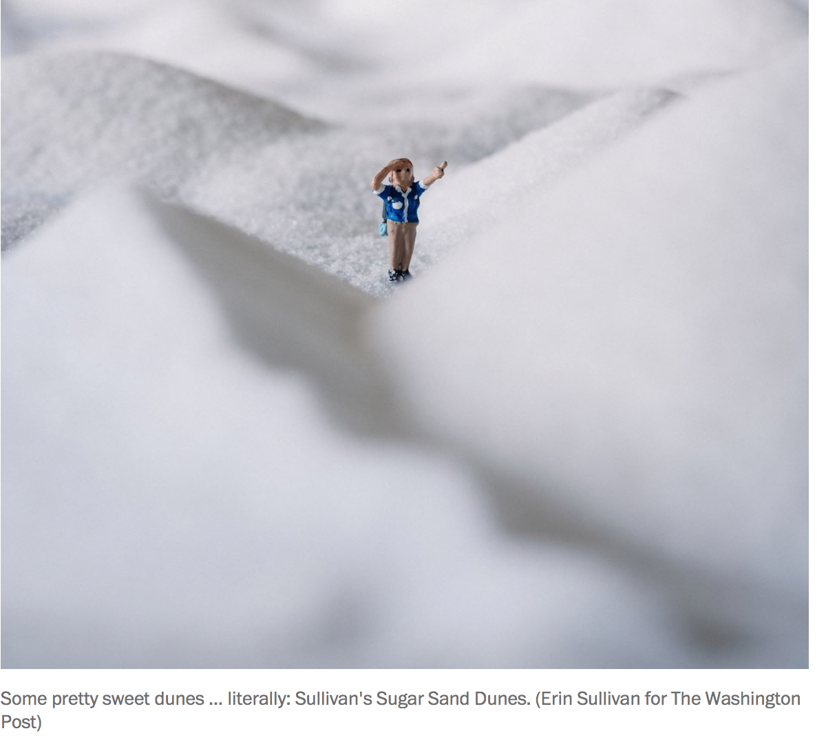
Scale and perspective mix up for amusement:
Day 1 “Small subject, big vision concept”
Bell Ringer: What is miniature photography?
Answer: Miniature Photography is simply one form of photographic artistry to mix the real with the surreal. Rather than simply building a scale model diorama portraying some kind of scene, the idea is to integrate true-scale, real-world objects, foods or 'entities' into the miniature world
Task #1: What small objects do you have around your house?
Questions to ask yourself:
Do you have adequate light where you live?
Do you have hot wheels cars?
Tiny figurines?
Small tiny toys from McDonald’s happy meals?
Could you make something?
Remember “Flat Stanley”, could you make a small one?
Cut an image of animal or person out of a magazine?
Task #2: Research online, or whatever resources you have access to, Photos where the photographer has manipulated the scene with a small object to appear it is in the real world. Click on each of the links below.
Photo crowd Examples. Travelminiscenes
Scene above ^ was created with sugar.
Task #3: How might you set up your own scene to photograph with your surrounding and what you have access to?

